Slide 1
Problem Statement
PS2 - Integrated Common Services to Common People.

Slide 2
Unique Idea Brief (Solution)
1. Introduction:
Our web application provides a centralized platform to access crucial information about educational institutions and healthcare facilities in Satara city. By offering detailed addresses, phone numbers, and ratings for schools, colleges, and hospitals, we aim to make essential services more accessible and user-friendly for the residents.
2. Key Features :
a) Comprehensive Listings: Detailed information on SSC, CBSE schools, colleges, and hospitals.
b) User-Friendly Interface: Simple and intuitive design using HTML, CSS, and JavaScript.
c) Contact Information: Easy access to addresses and phone numbers.Ratings: User ratings to help make informed decisions.
3. Benefits:
a) Convenience: Centralized access to crucial information saves time and effort.
b) Informed Choices: Ratings help users make better decisions regarding their educational and healthcare needs.
c) Improved Accessibility: Easy-to-use platform ensures that users can quickly find the information they need.

Slide 3
Brief Solution: 1. Education Services: a) School and College Listings: Comprehensive database of SSC and CBSE schools, and colleges in Satara, displaying addresses, phone numbers, and ratings. b) Search and Filters: Simple search functionality allowing users to find institutions based on name or type. C) Ratings: User ratings provide insights into the quality of education and facilities. 2. Healthcare Services: a) Hospital Listings: Detailed profiles of hospitals in Satara, including addresses, phone numbers, and ratings. b) Emergency Services: Information on emergency contacts and services provided by hospitals. 3.Technology Stack: a) Frontend: Developed using HTML, CSS, and JavaScript for a straightforward and responsive user interface. b) HTML: Structures the content and layout of the web pages. c) CSS: Styles the web pages to ensure a visually appealing and consistent look and feel. d) JavaScript: Adds interactivity and dynamic features to the website, such as search filters and rating functionalities.

Slide 4
Features Offered
Comprehensive Listings:
a) Schools and Colleges:
SSC and CBSE Schools: Detailed profiles including addresses, phone numbers, and user ratings.
Colleges: Comprehensive information on colleges, including addresses, phone numbers, and user ratings.
b) Hospitals:
General Hospitals: Information on available services, contact details, and ratings.
Specialty Hospitals: Detailed profiles of hospitals specializing in various medical fields, including contact information and user ratings.
2. User-Friendly Interface:
a) Intuitive Design: Simple and clean layout ensuring easy navigation.
b) Responsive Design: Optimized for use on both desktop and mobile devices, ensuring accessibility on the go.
3. Contact Information:
a) Addresses: Accurate and up-to-date addresses for schools, colleges, and hospitals.
b) Phone Numbers: Direct contact numbers to reach the institutions easily.
4. Map Integration:
Location Mapping: Integration with map services to show the exact location of schools, colleges, and hospitals.
By incorporating these features, our web application provides a comprehensive and user-friendly platform for accessing essential educational and healthcare services in Satara city.

Slide 5
Process flow
1. Requirements Gathering:
a) Objective: Define the goal of providing information on SSC and CBSE schools and hospitals in Satara.
b) Research: Identify needed features and information based on user needs.
2. Planning:
a) Timeline: Create a schedule for design, development, and testing phases.
b) Resources: Plan the use of HTML, CSS, and JavaScript for development.
c) Risk Management: Identify potential challenges and mitigation strategies.
3. Design:
a) Wireframing: Sketch basic layouts for the web application.
b) UI/UX Design:
c) HTML: Structure content with semantic elements.
d) CSS: Style the application for visual appeal and responsiveness.
e) JavaScript: Plan interactive features like search and form validation.
4. Development:
a) HTML: Build the page structure and content.
b) CSS: Apply styles for layout, colors, and responsive design.
c) JavaScript: Implement functionality for search, form validation, and dynamic updates.

Slide 6
Process Flow
5. Testing:
a) Unit Testing: Test individual components for functionality.
b) Cross-Browser Testing: Ensure compatibility across different browsers.
c) Responsiveness Testing: Verify the application works on various devices.
6. Maintenance and Updates:
a) Monitoring: Check for bugs and issues.
b) Feedback Collection: Gather user feedback for improvements.
c) Updates: Implement changes based on feedback and new requirements.

Slide 7
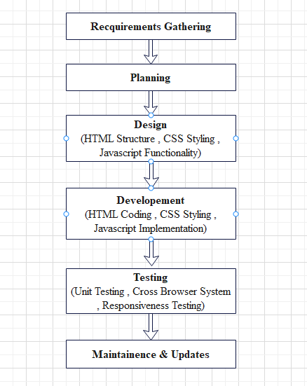
Process Flow Diagram

Slide 8
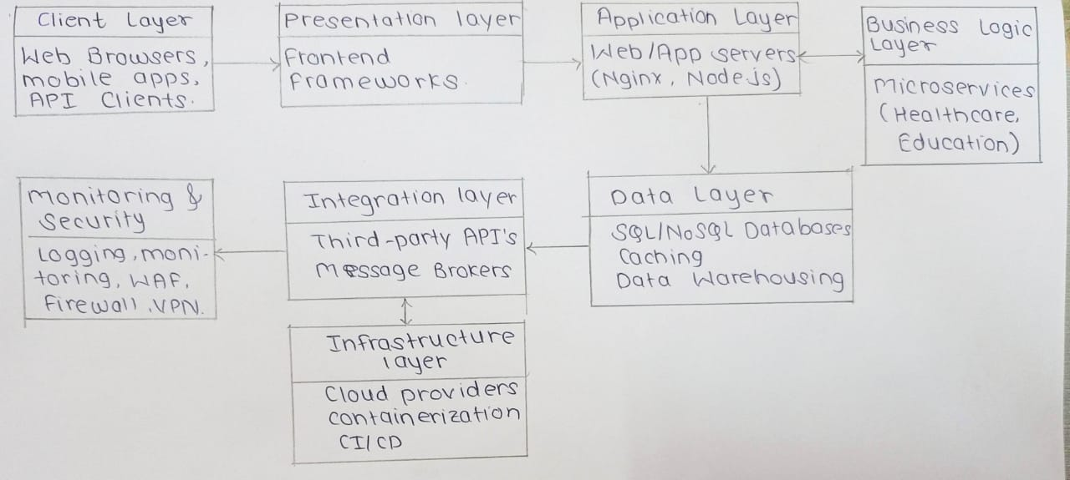
Architecture Diagram

Slide 9
Technologies used
HTML (HyperText Markup Language):
a) Structure: HTML is used to structure the web pages and organize the content, providing the backbone for the application. b) Elements: Utilizes various HTML elements like headers, paragraphs, links, lists, and forms to create a comprehensive and accessible interface. c) Semantic Tags: Employs semantic HTML tags to enhance the accessibility and SEO of the website. 2. CSS (Cascading Style Sheets):
a) Styling: CSS is used to style the web pages, ensuring a visually appealing and consistent look and feel. b) Layout: Implements flexible layouts using CSS Grid and Flexbox to create responsive designs that work across different devices. c) Themes and Customization: Allows for easy customization of the website’s appearance, enabling theme changes and visual adjustments.

Slide 10
Technologies used
3. JavaScript:
a) Interactivity: JavaScript adds interactivity and dynamic behavior to the website, enhancing user engagement and experience. b) Event Handling: Manages user interactions such as clicks, form submissions, and hover events to create a responsive user interface.

Slide 11
Team members and contribution:
1) Samruddhi Shedage : Observing and maintaining coordination between teammates as well as analyzing all the suggestions from the teammates and deciding how it can be implemented in efficient way.
Education Section : Created an Engineering College page (Data collection, HTML structure, CSS styling ).
Styling a Home page.
2) Vaibhavi Kalase : Education Section : Created a SSC School page (Data collection, HTML structure, CSS styling )
Hospital Section : CSS styling.
Designed Header Section of all pages.
3) Rutuja Chavan : Education Section : Created a CBSC School page (Data collection, HTML structure, CSS styling ).
Designed Footer Section of all pages .
4) Gayatri Dhanave: Education Section : Created Junior College page (Data collection, HTML structure,).
Hospital section :Created a Hospital page (Data collection, HTML structure,)
5) Pradip Dhanawade: Created a About Us Page (HTML structure, CSS styling ).
Created a Home Page(HTML Structure).

Slide 12
Conclusion
1) Throughout our internship, we embarked on developing a web application aimed at delivering integrated common services to the residents of Satara City. Our focus areas were education and healthcare, providing detailed and accessible information on SSC and CBSE schools, colleges, and hospitals.
2) This project has been a testament to the power of technology in serving community needs. By providing a centralized platform for educational and healthcare services, we have created a valuable tool for the residents of Satara City. Our application not only meets current demands but also has the potential for significant future growth and development. We are enthusiastic about the continued evolution of this project and its positive impact on the community.

